Slide 1
Starting from the “Scratch”

Slide 2
What is programming?
Make an algorithm to do something in a specific language programming.
Algorithm: a procedure or formula for solving a problem.
Programming language: artificial language designed tocommunicate instructions to a machine.
It also involves the process of designing, writing, testing, debugging, and maintaining the source code of a computer program.

Slide 3
What is Arduino?
It's an open source electronics prototyping platform:
Open source: resources that can be used, redistributed or rewritten free of charge, often software or hardware.
Electronics: technology which makes use of the controlled motion of electrons through different media.
Prototyping: an original form that can serve as a basis or standard for other things.
Platform: hardware architecture with software framework on which other software can run.

Slide 4
The Arduino board is like a small computer that can be programmed as many times as needed.
As a computer, it provides I/O interaction, through digital (inputand output) and analog input pins.
Digital: discrete and finit, described in two states: 1/0, ON/OFF.
Analog: continuous, can have infinite number of values.
The sketch made with the Arduino IDE is loaded to the board and stored in the microcontroller.

Slide 5
Breakdown of a Arduino(Uno) board

Slide 6
What is Scratch?
It's an open source and educational software focused mainly for children, designed by the Lifelong Kindergarten group at MIT, and implemented in Smalltalk (Squeak).
The programming instructions are pieces that have to be stick to each other in an order to form blocks and make a coherent program, just like a puzzle.

Slide 7
What is S4A?
Scratch for Arduino (S4A) is a modified version of Scratch ready for communication with Arduino boards.
An Arduino sketch (S4AFirmware) has to be loaded to the board to work properly with S4A.

Slide 8
Pin mapping in S4A
Digital read: digital pins 2 and 3.
Digital write: digital pins 10, 11 and 13.
Analog read: analog pins 0-5.
Analog write: digital pins 5, 6 and 9.
Servo control:
digital pins 4, 7 (continuous rotation).
8 and 12 (standard).

Slide 9
Basic electronics: Ohm's Law
Electricity if the flow of energy (electrons) through a conductive material.
Voltage (V): is the measure of electrical potential, measured in Volts (V).
Current (I): is the amount of flow through a conductive material, measured in Amperes or Amps (A).
Resistance (R): is the material's opposition to the flow of electric current, measured in Ohms (Ω).

Slide 10
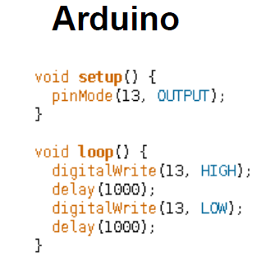
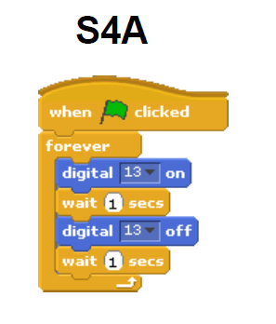
Quick comparison: Blink
Comparison of a simple program that blinks a LED connected to pin 13 on Arduino and in S4A. We can appreciate the differences between the form and syntax of programming languages in both cases:

